Slide 1
Bulk Import Vendors via AW UI for TcX
Ashutosh Korde(Summer Intern Siemens DISW)

Slide 2
Problem statement
Solution approach
Demonstration of the solution
Key take aways / learnings from the project
Future work
Acknowledgement
Q&A

Slide 3

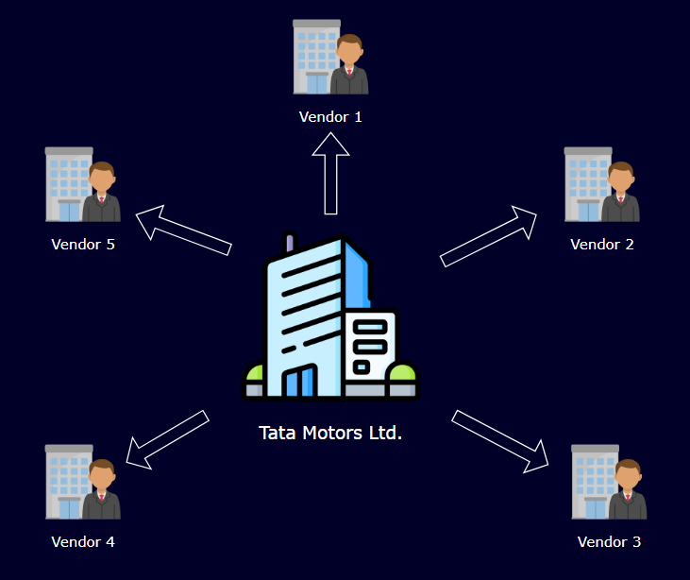
Problem Statement
Bulk Import Vendors via AW UI for TcX
Why Bulk Import Vendors
Existing Solution & Limitation
Proposed Solution

Slide 4

Solution Approach
Leveraged csv2tcxml & tcxml_import utilities to avoid reinventing the wheel.
Created a SOA service which executes utilities to achieve bulk data import.
Provided user-friendly UI in the active workspace for users to execute Bulk Vendor Data Import utility.

Slide 5
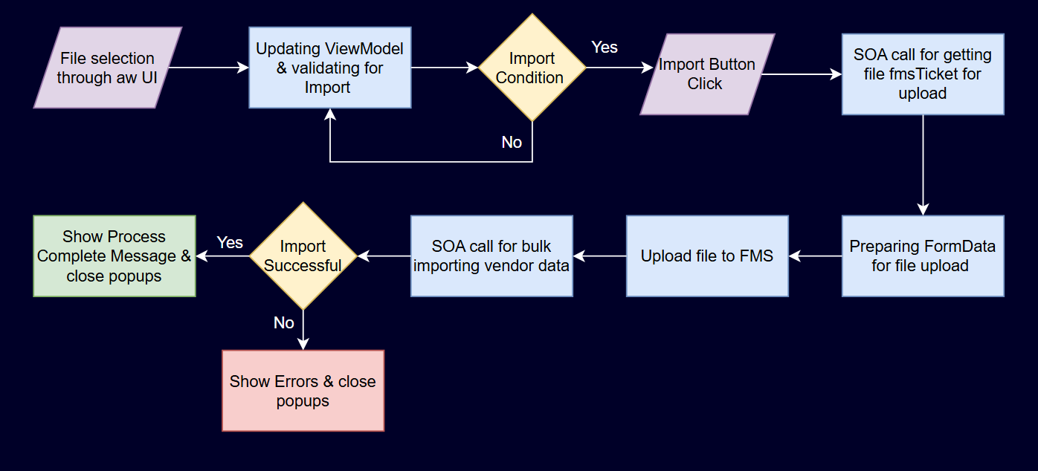
Process Flow

Slide 6
Utilities Overview
CSV2TCXML
The utility converts data provided in the csv into tcxml.
Relations between the objects needs to be defined in the header of the csv.
Existing admin objects such as user can be referred using their candidate key.
Must contain a primary object in csv in each row for islands to be created around it.
TCXML_IMPORT
The utility creates the objects island by island present in the tcxml file.
Refers to stub objects at the instance of object creation if referenced object does not exist.
We use the utility in -bulk_import mode to use POM level api’s for fast import.
In case of failure generates xml file with failed island data.

Slide 7
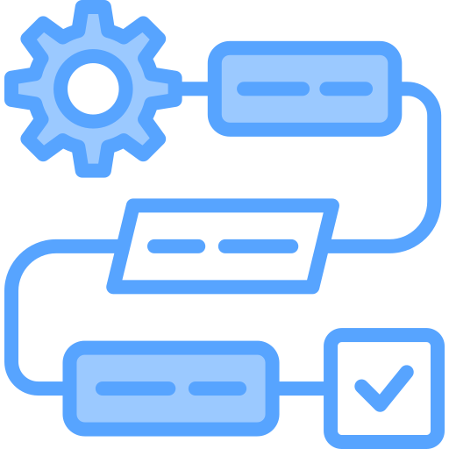
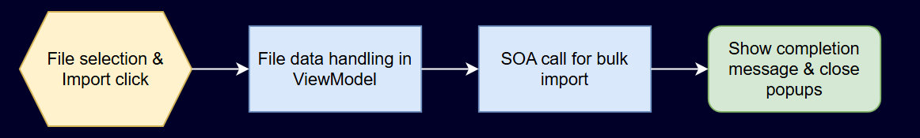
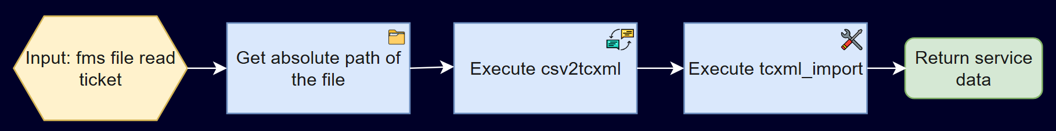
Process Flow & SOA
Process Flow
SOA

Slide 8

Solution Demonstration

Slide 9

Future Steps
Error handling needs to be more robust and thoroughly tested.
File validation needs to be added to check the syntax of content in the CSV file.
Synchronous SOA will be converted to async SOA.

Slide 10

Learnings & Key Takeaways
Development Learnings
Gained practical experience with AW’s MVVM-driven UI architecture and event-driven workflows.
Learned to interact with Teamcenter SOA/REST APIs for executing business logic.
Learned creating SOA using BMIDE to handle business logic.
Gained knowledge about build structure & how to resolve build errors.
Figured out working and usage of csv2tcxml & tcxml_import utilities.
Takeaways
Gained valuable insights into enterprise solution i.e. Teamcenter.
Personal Growth both technical & non-technical.

Slide 11
Key Takeaways
Gained understanding of enterprise PLM systems & developed initial insights into how customization of their data models, workflows, and integrations is done to fit different business needs.
Gained valuable insights into managing and organizing a large-scale Teamcenter codebase, including the use of abstraction and modularity. Learned how these principles are applied to maintain clarity, flexibility, and long-term sustainability in enterprise PLM systems.
Enhanced my skills in understanding code, visualizing process flows, debugging.
Overall as the first experience in corporate shrugged my nervousness and built confidence in my ability to contribute and be productive in a professional environment.

Slide 12
Acknowledgement
Manager
Chandar Panjwani.
Mentors
Praveen Kamatnurkar.
Priyanka Bhise.
Ishrat Shaikh.

Slide 13
Q&A

